Slide 2
Aim
I can discuss things I am thankful for and I can focus on the things I do have, rather than the things I do not have.
Success Criteria
I can name things I am thankful for.
I can show my gratitude in different ways.
I understand that being thankful makes me and others happy.

Slide 3
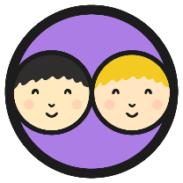
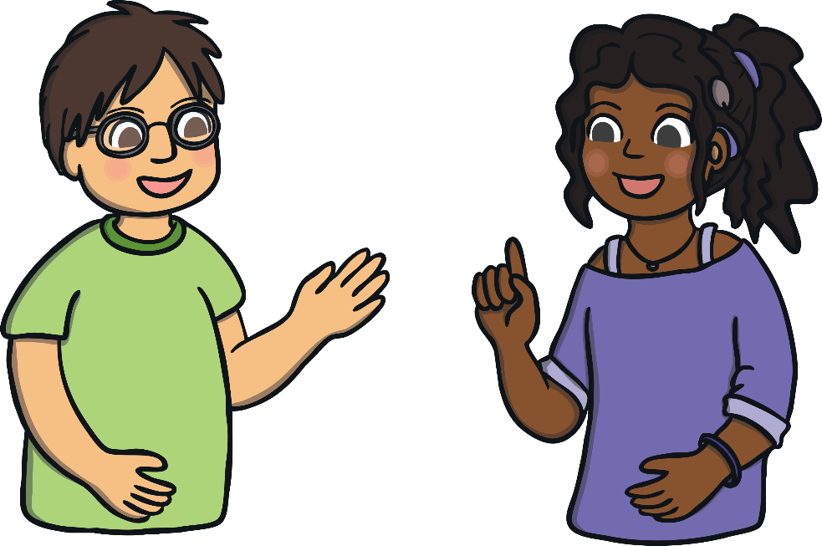
Saying Thank You
When was the last time you said thank you?
Thank you!
Why do we say thank you?
Saying thank you makes us and the other person feel good!

Slide 4

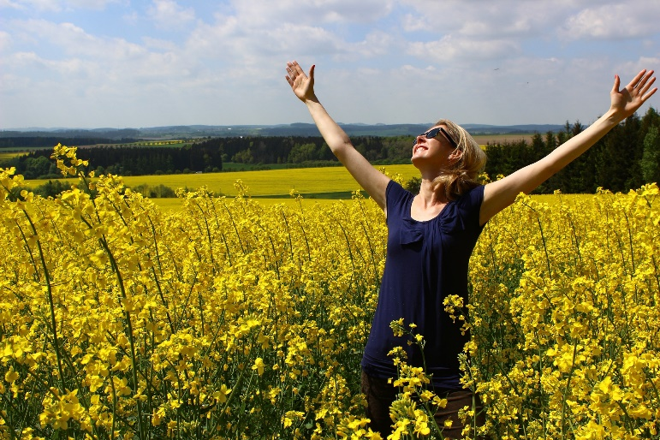
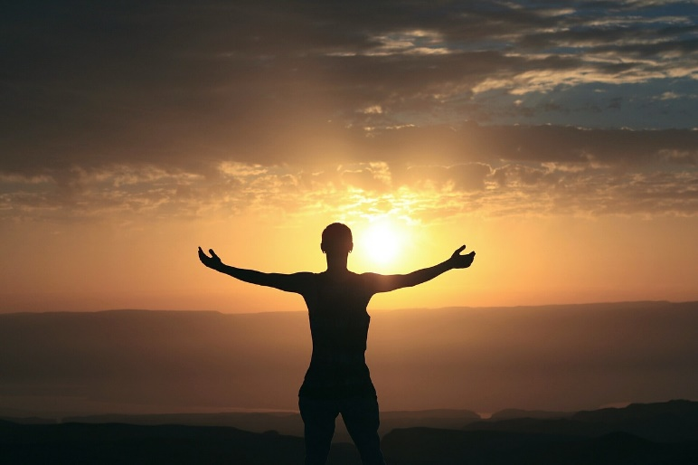
Being Grateful
What does being grateful mean?
Being grateful (or thankful) means that you appreciate things you have in your life, including the people you have around you.
If you appreciate things, it means you are pleased when you think of all the things you have and you realise how lucky you are.

Slide 5
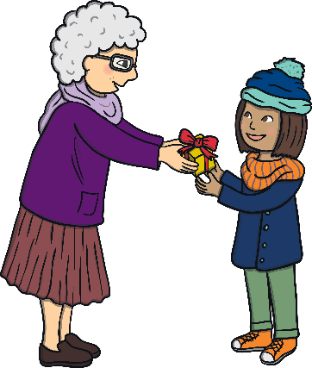
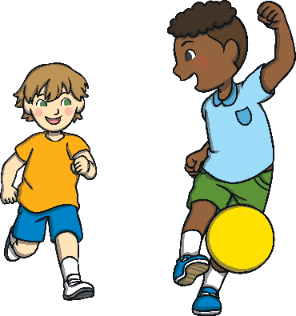


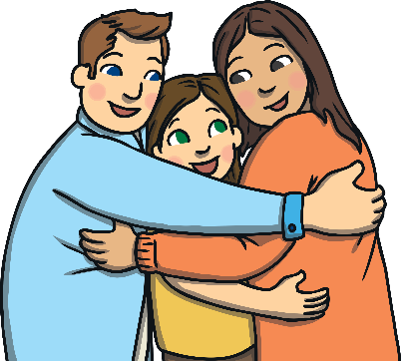
Being Grateful
How can we be grateful, or thankful, towards others?

Slide 6
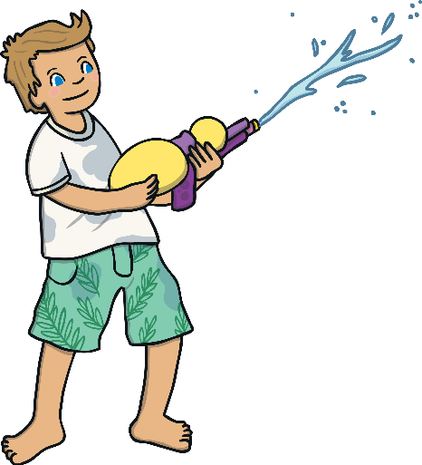

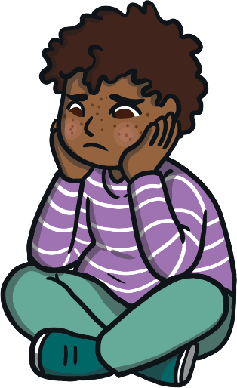
Being Grateful
How can we be grateful, or thankful, for what we have?
we can think about those who are not as lucky as we are;
We can enjoy what we have;
we can look after what we have.

Slide 7
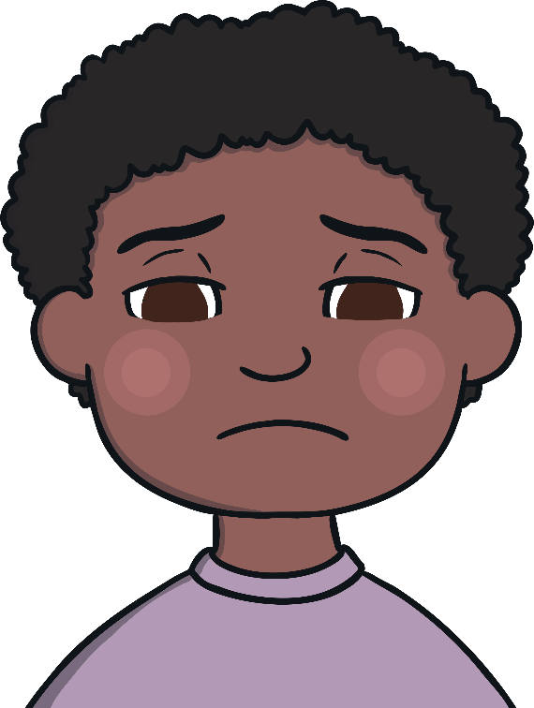
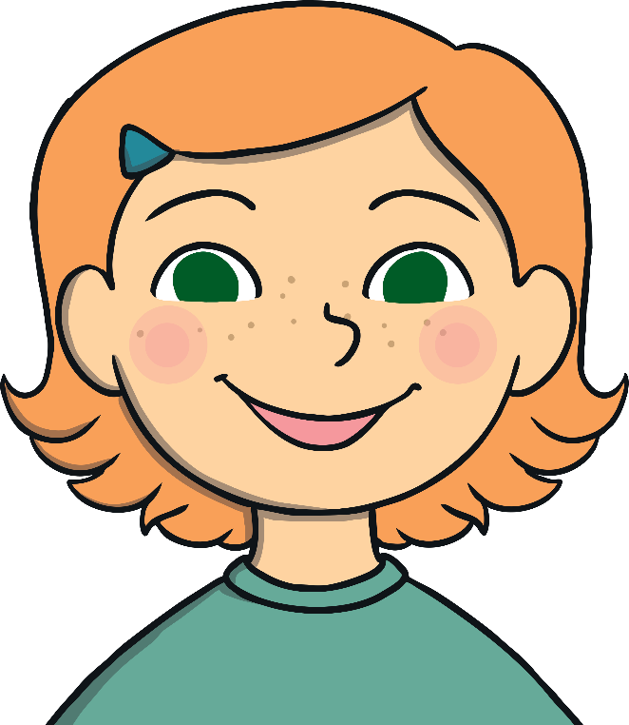
Thankful People are Happy People
How can being thankful make you happy?

Slide 8
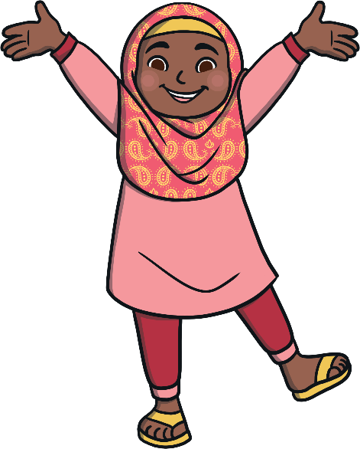
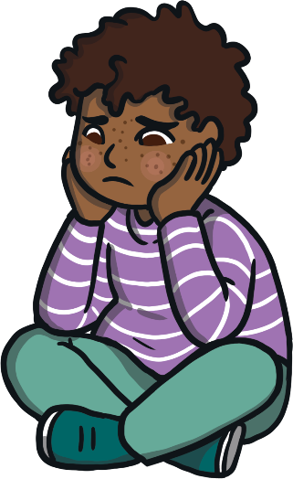
Thankful People are Happy People
If we think positive thoughts, we feel happier.
If we think negative thoughts, we don’t feel so good.
If we focus on the things we have and think how lucky we are, we will feel good, because this is a positive thought.
If we think about all the things we don’t have, we will feel miserable all the time, as this is a negative thought.

Slide 9
Thankful People are Happy People
Think carefully about this quote…
Happiness isn’t about getting what you want all the time.
It’s about loving what you have and being grateful for it.

